Slide 1


Slide 2

10-1 FUTURE TIME: USING BE -ING
I am going
downtown tomorrow.

Slide 3

10-2 USING THE PRESENT PROGRESSIVE TO EXPRESS
FUTURE TIME
Sela is leaving at noon tomorrow.

Slide 4
10-2 USING THE PRESENT PROGRESSIVE TO EXPRESS
FUTURE TIME
(a) Sela is going to leave at noon tomorrow.
(b) Sela is leaving at noon tomorrow.
same meaning

Slide 5
10-2 USING THE PRESENT PROGRESSIVE TO EXPRESS
FUTURE TIME
(c) They are going to fly to Tokyo tomorrow.
(d) They are flying to Tokyo tomorrow.
same meaning

Slide 6
10-2 USING THE PRESENT PROGRESSIVE TO EXPRESS
FUTURE TIME
Common Verbs
come
do
drive
fly
go
leave
meet
return
spend
start
stay
take

Slide 7
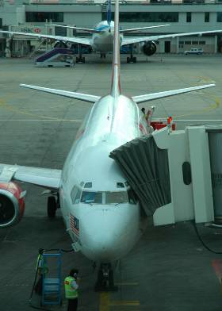
10-2 Let’s Practice
They are going to fly
to Ghana on Monday.
They are
flying to
Ghana on Monday
.
present continuous

Slide 8
10-2 Let’s Practice
They are going to leave at 9:00 tomorrow.
They are leaving at 9:00 tomorrow
.
present continuous

Slide 9
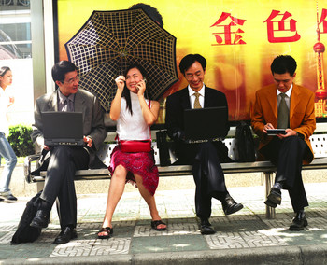
10-2 Let’s Practice
I am going to meet her at the bus stop.
I am meeting her at the bus stop
.
present continuous

Slide 10
10-3 WORDS USED FOR PAST TIME AND FUTURE TIME
PAST
FUTURE
month month
year year
weekend weekend
spring spring
last
next
She went home
last spring.
She’s going home next spring.

Slide 11
10-3 WORDS USED FOR PAST TIME AND FUTURE TIME
PAST
FUTURE
... minutes ago in ... minutes (from now)
... days ago in ... days (from now)
... weeks ago in ... weeks (from now)
... months ago in ... months (from now)
... years ago in ... years (from now)
I washed some
of the dishes ten
minutes ago.
Jay is coming in five minutes.

Slide 12
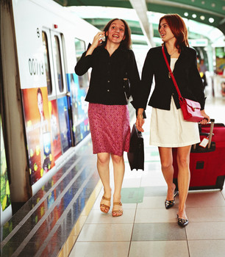
10-3 Let’s Practice
next
They are arriving ______ weekend.
yesterday
last
tomorrow
next

Slide 13
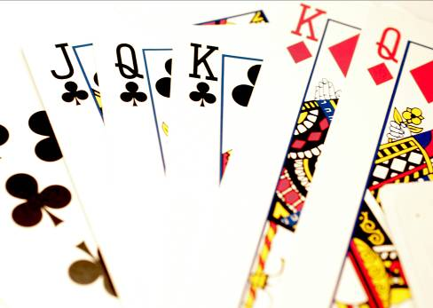
10-3 Let’s Practice
tomorrow
They are playing cards ________.
yesterday
last
tomorrow
next

